Slide 1


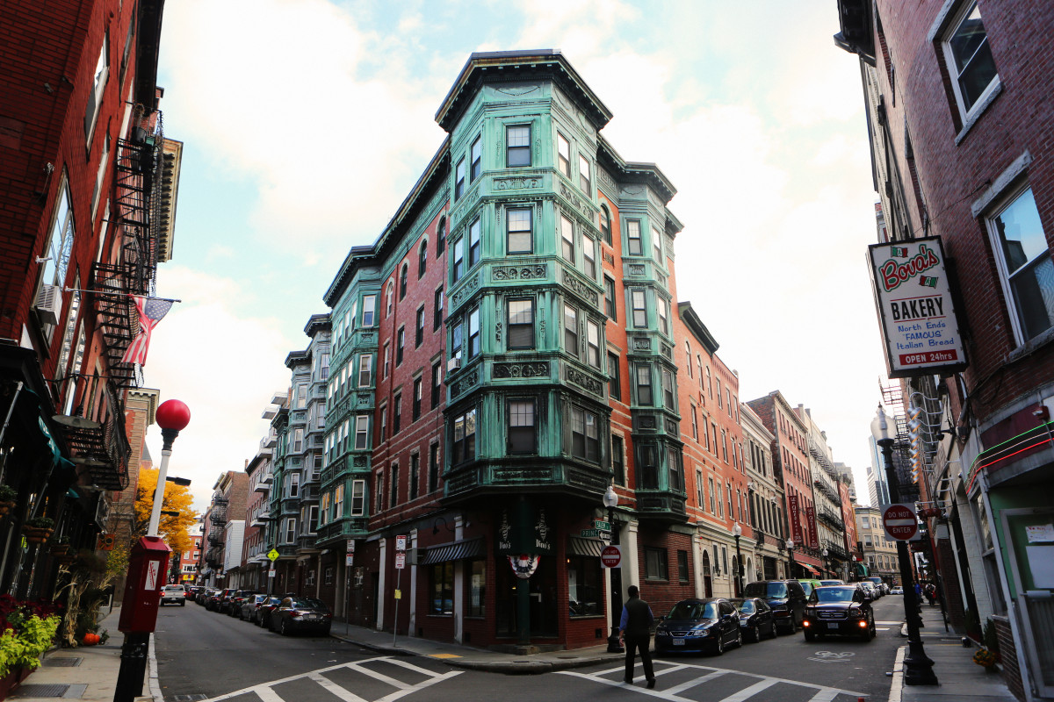
BOSTON AIRBNB ANALYSIS
Akshata Thopte,
Rakesh Reddy,
Riddhi Umap,
Shelly Garg

Slide 2

Agenda
Business Problem Statement
Data Collection
Exploratory Data Analysis
Data Preprocessing
Data mining Model
Result
Conclusion

Slide 3
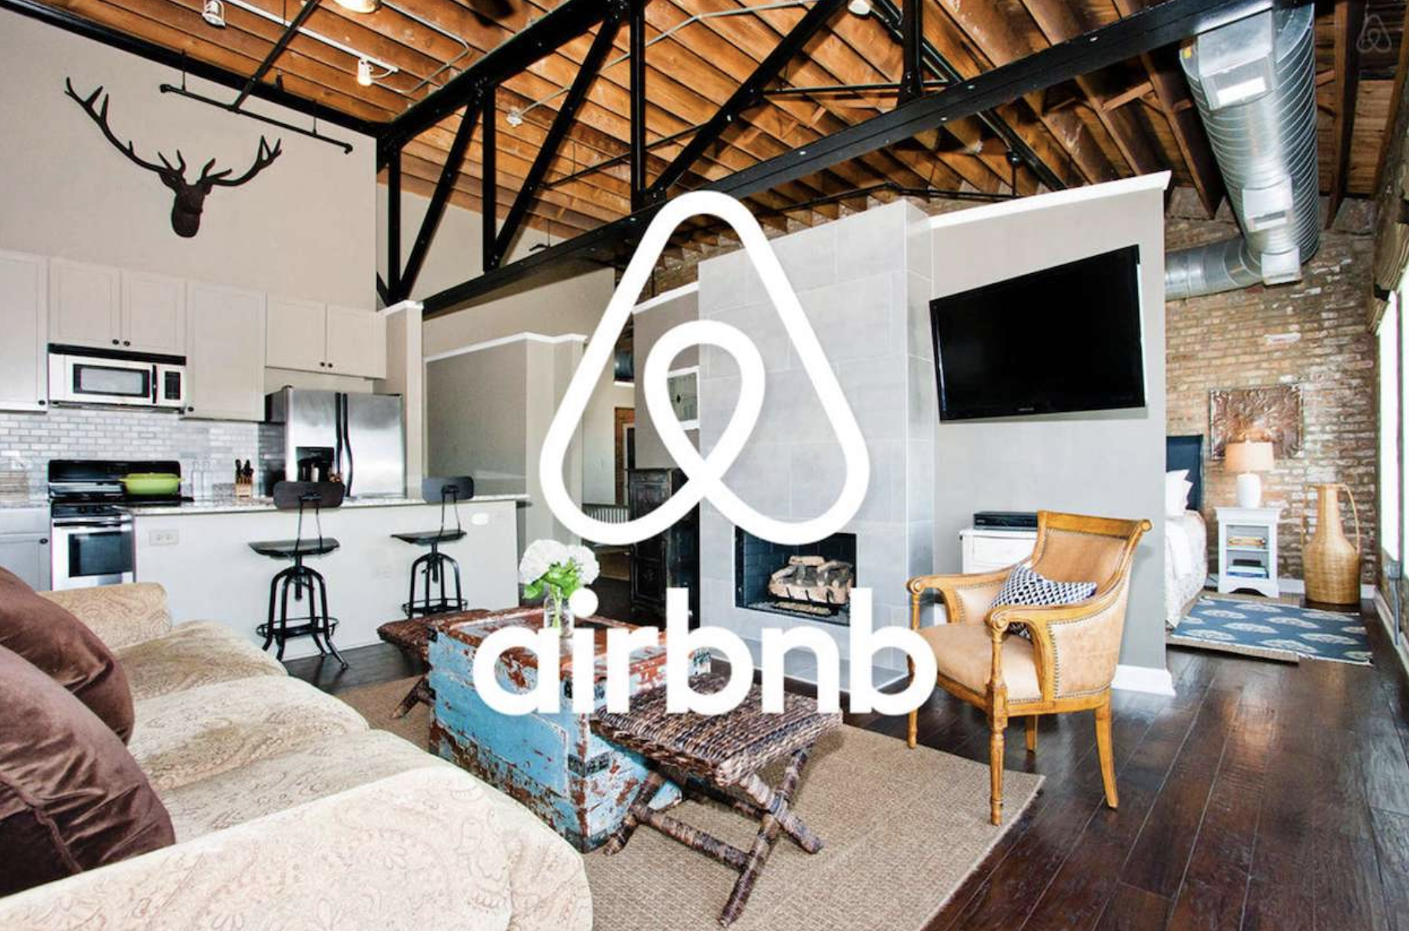
BUSINESS PROBLEM STATEMENT
How well can we predict a listing's price and what features correlate well with the pricing?
Where to invest in a property in Boston to get the maximum number of returns from Airbnb?
How well can we predict reviews and what aspects are correlated with the reviews?

Slide 4
DATA COLLECTION
Data is collected from Inside Airbnb: Boston
listings.csv - a comprehensive description of all the Airbnb listings in Boston, including details such as price, number of guests it can accommodate, ratings, number of reviews, and more(3586, 69)
Calender.csv -the availability of the listings and their corresponding prices(184789,6)
Reviews.csv - record of the reviews left by guests for each individual listing in Boston.(1410023,13)

Slide 5
DATA Preprocessing
Dropped unwanted columns and replaced Nan values with 0
Excluded all listings with 0 values for price, beds, bedrooms, and accommodations, etc.
Extracted prices from the table and cleaned the data to make it float, then created a new column for prices
Added separate columns for date, day, month, year, and USA Holiday from the date column
Removed non-English reviews and Split the amenities list to count the number of amenities
Converted categorical variables (flexible, moderate, strict, super_strict_30) into indicator variables of cancellation policy by creating dummy variables
Split the amenities list to count the number of amenities
Descriptive statistic for price is mean : 168.48 and standard deviation : 117.47

Slide 6

EXPLORATORY DATA ANALYSIS

Slide 7
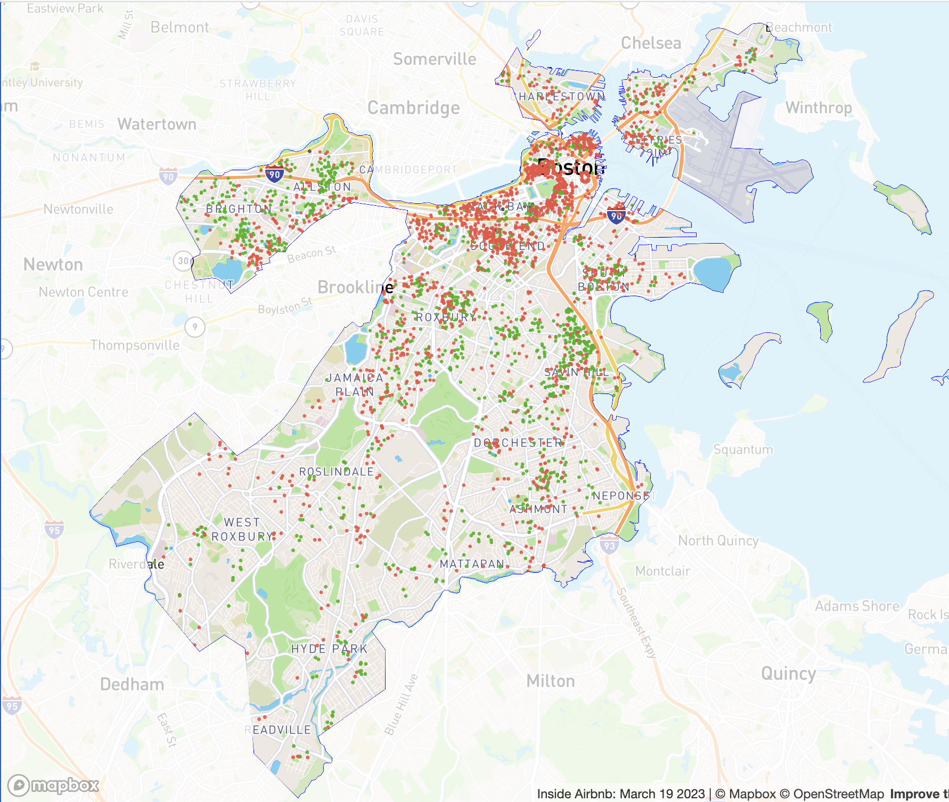
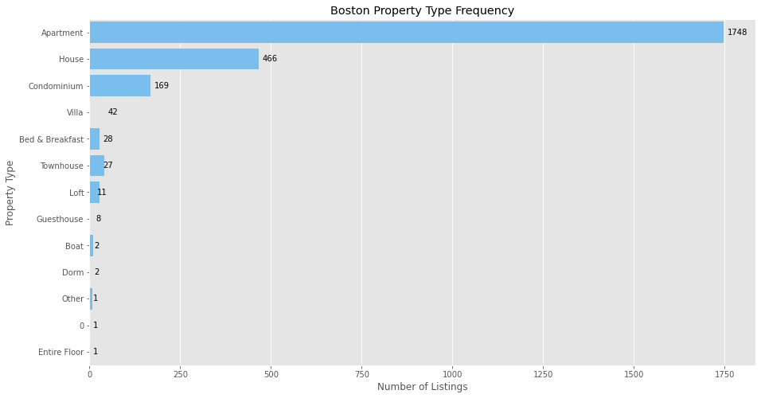
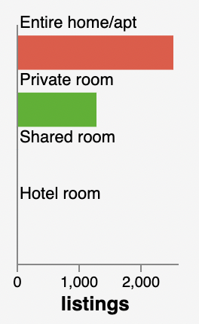
Frequency of Boston Property Types Listed on Airbnb
Apartments and homes dominate Boston's Airbnb listings, whereas boats, villas and other are far less popular.

Slide 8
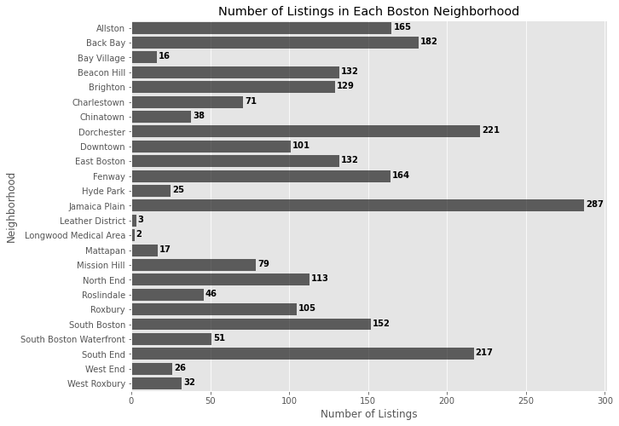
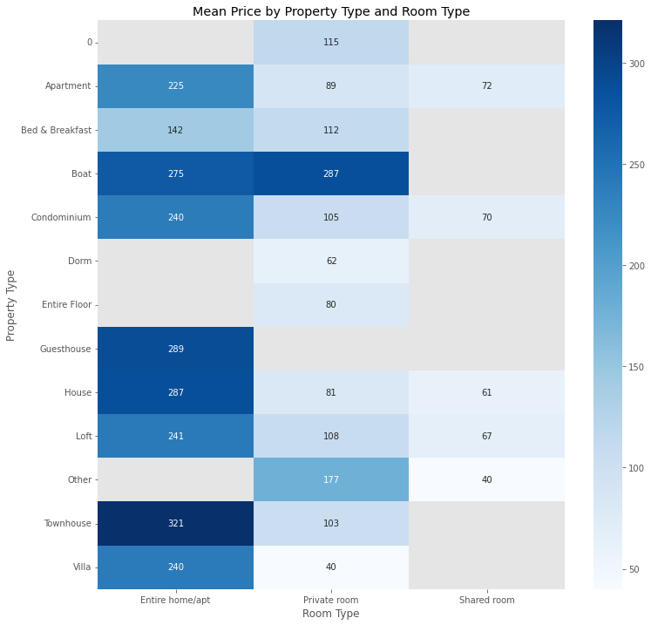
Jamaica Plain has the highest number of entire apartment listings
Longwood Medical Area has the least
The data is valuable for hosts to check the number of listings for entire apartments in a specific neighborhood in Boston.
Entire homes/apartments are generally more expensive than private/shared rooms.
Townhouse, Guesthouse, House and Boat have the highest mean price while dorms have the lowest mean price.

Slide 9
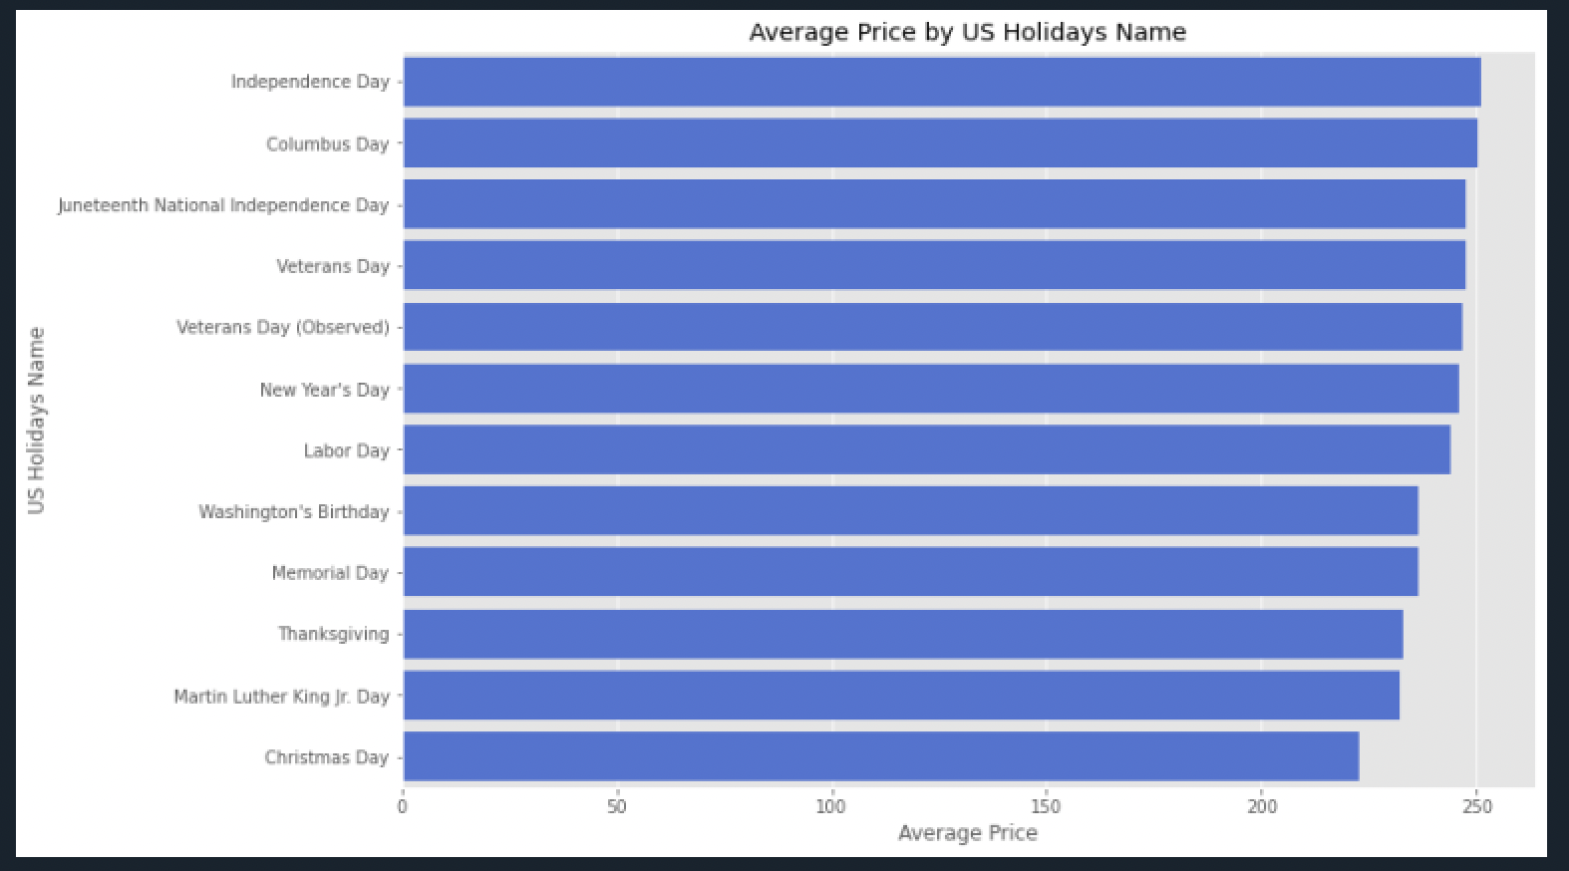
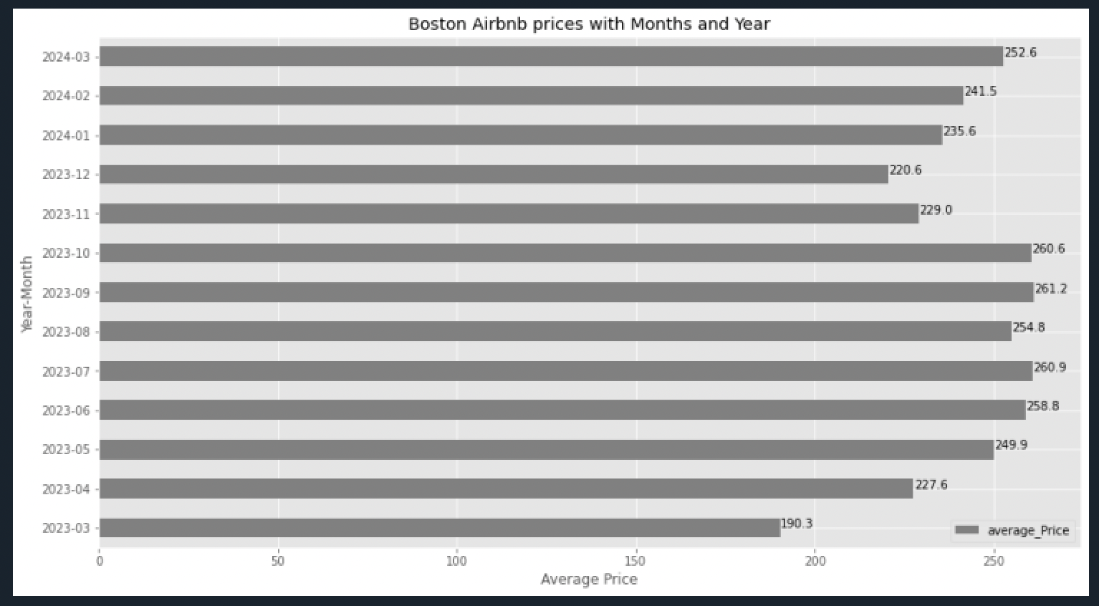
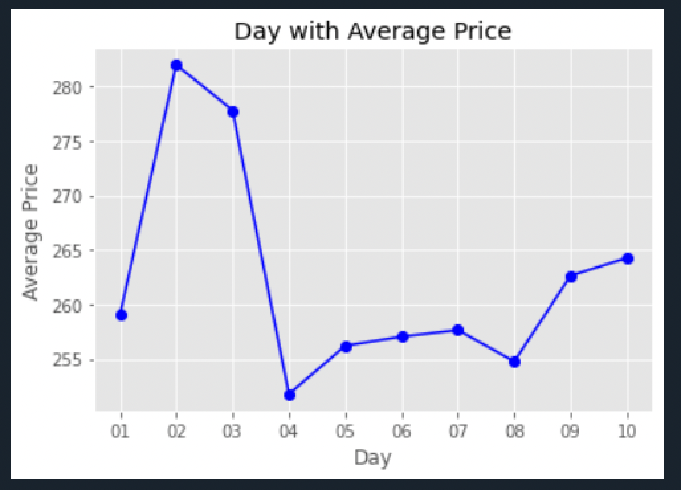
The highest rates for listings occurred in July, September, and October, with an average price around $260
Considered the most popular holidays in the United States, the 4th of July (Independence Day) had the highest average price among them.
Examined a period that included both long weekends and regular days from July 1st to 10th, and observed that during long weekends, prices were higher compared to regular days.

Slide 10
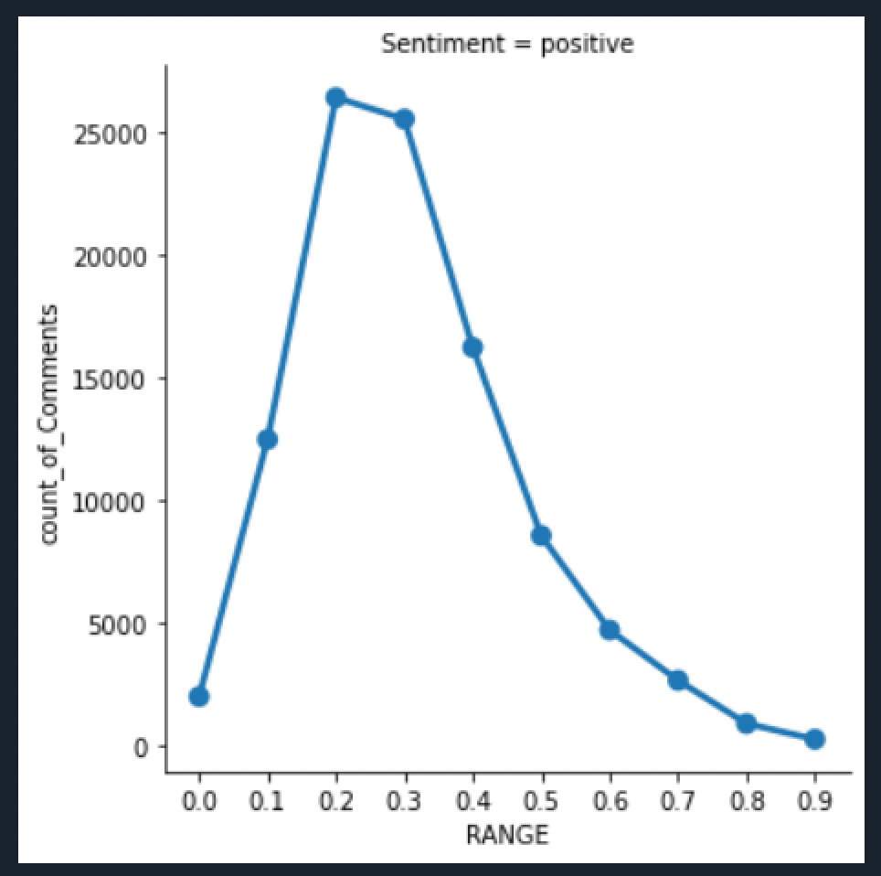
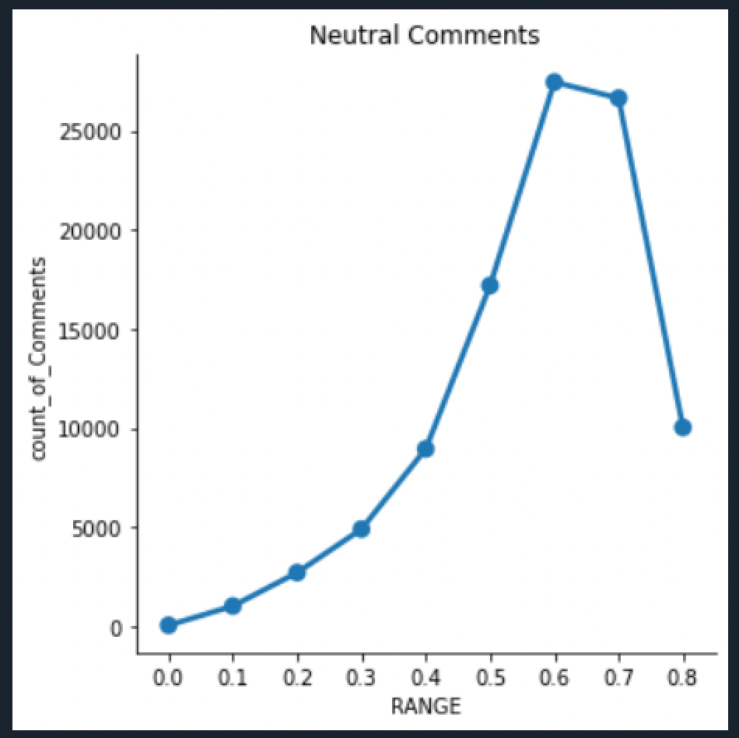
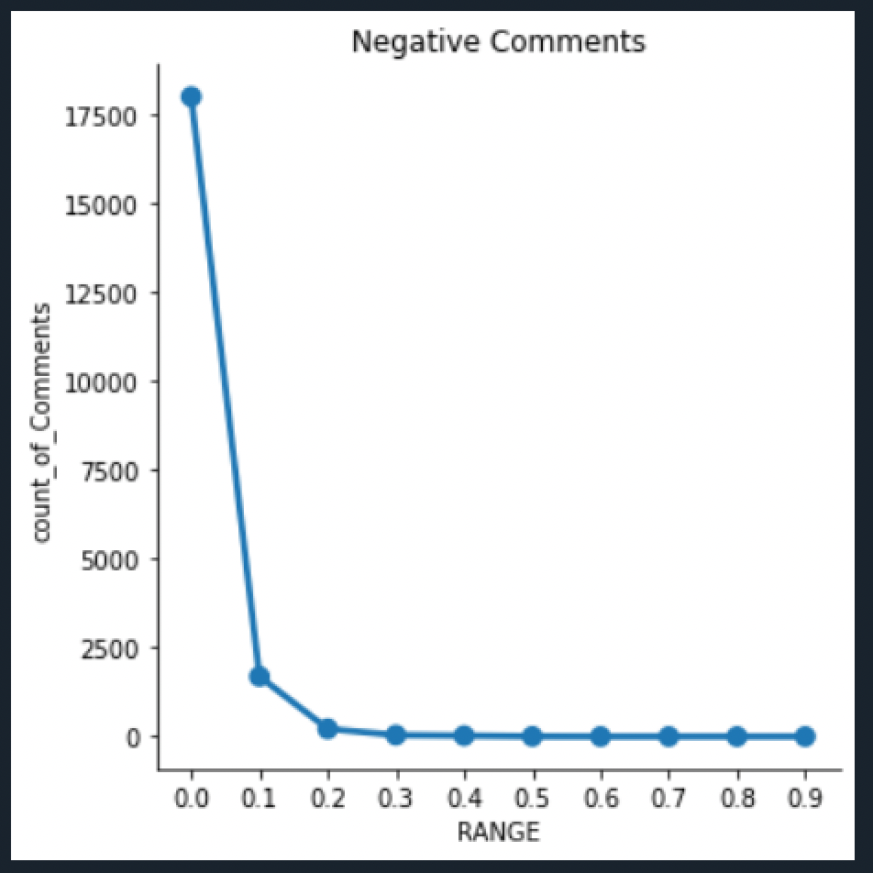
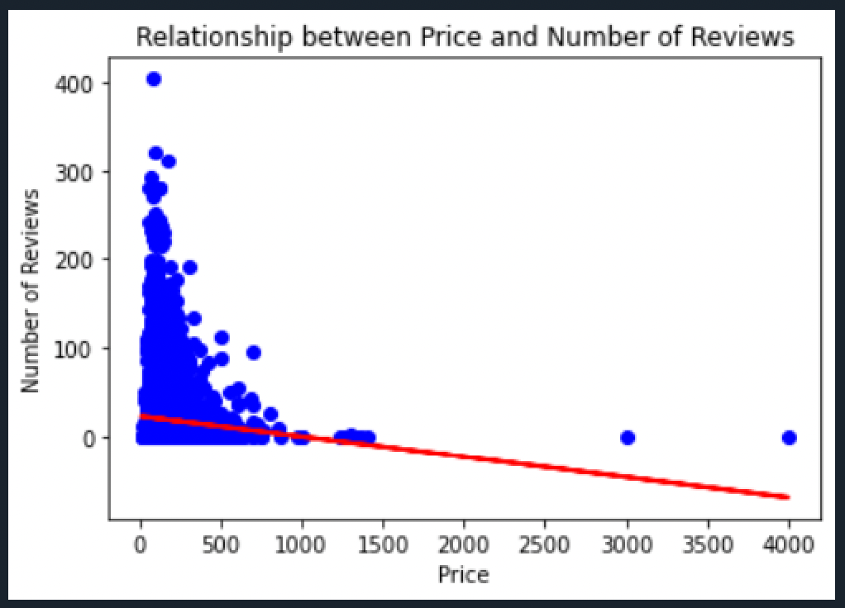
Sentiment Analysis and Linear Regression Model
A significant amount of them are given exactly 0.0 negativity
Linear Regression between Price and Number of Reviews
A significant amount range of comments are positive
Graph has upward trend and most of the comments are neutral

Slide 11
DATA MINING MODEL
Feature Engineering: Created 'amenities_count' to capture number of amenities.
Label Encoding: Converted categorical variables to numerical values for ML.
Data Splitting and One-Hot Encoding: Split data into train/test sets and encoded categorical variables.
Model Training: Used Scikit-learn's LinearRegression class to predict price.
Model Evaluation: Evaluated using mean squared error and R-squared.
Prediction: Used trained model to predict price based on user input

Slide 12

RESULT
Price recommendation system for host based on property type, neighborhood, and amenities.
High budget recommendation: Townhouse in South End with 10 amenities, priced at $140.15.
Low budget recommendation: Dorm in West Roxbury with 3 amenities, priced at $112.76.
Popular neighborhood recommendation: Apartment in Jamaica Plain with 5 amenities, priced at $120.58.
The system considers different factors to provide tailored price recommendations for hosts.

Slide 13
CONCLUSION
Invest in properties in popular Boston neighborhoods with high demand and access to amenities/attractions for maximum Airbnb returns
Based on the sentiment analysis of reviews, it appears that there are a significant number of neutral comments, but the overall sentiment is more positive than negative.
Utilized a data-driven approach to provide tailored price recommendations that help hosts optimize their listings and maximize earnings

Slide 14
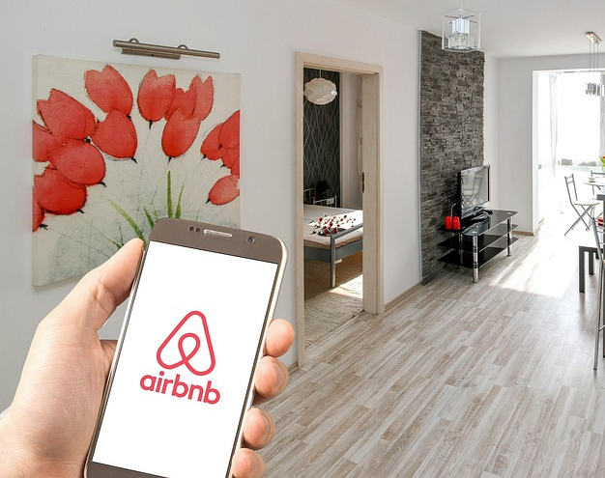
THANK YOU

